Slide 1
Aura Watches Website Project
A user-friendly Aura Watches website built using HTML5, CSS, JavaScript, and Bootstrap
Muhammad Rizwan
Mohammad Talha

Slide 2
Problem Statement
The Home Page should have suitable logo, and decent color combination.
The site should display a menu which will contain the options as Products, Technology, Store Locator, Support etc.
Various pages having information about different types of watches and clocks, Technology used in the watches etc.
The information should be categorized according to different Product Line-up e.g. “SPORTZ”, “PREMIER” etc.
When a user selects any product line-up, complete list of watches for that product line-up will be displayed.
Details of the watches should be displayed on the Web Page along with the title and it should be stored in Individual Word documents which can be downloaded or viewed by the User who wishes to see the same.
Price List for all watches should be available for download.
There should be a “Contact Us” page which will have the Address of the Stores selling watches and the mail address which when clicked will invoke the local mail client from where they can send an email.

Slide 3
Project Objective
The Objective of this program is to give a sample project to work on real life projects. These applications help you build a larger more robust application.
The objective is not to teach you JavaScript/Dreamweaver but to provide you with a real life scenario and help you create basic applications using the tools.
You can revise the chapters before you start with the project.
This project is meant for students who have completed the module of Dreamweaver. These programs should be done in the Lab sessions with assistance of the faculty if required.
It is very essential that a student has a clear understanding of the subject. Students should go through the project and solve the assignments as per requirements given.
Kindly get back to E-Projects Team in case of any doubts regarding the application or its objectives.

Slide 4
Tools & Technologies Used
HTML5 for structuring the web pages
CSS3 & Bootstrap for styling and responsiveness
JavaScript for interactivity

Slide 5
Website Structure
Home Page
Categories: Sportz Watches, Premier Watches, Luxury Watches
Form
Add Static Maps
Navigation menu at top for Watches

Slide 6
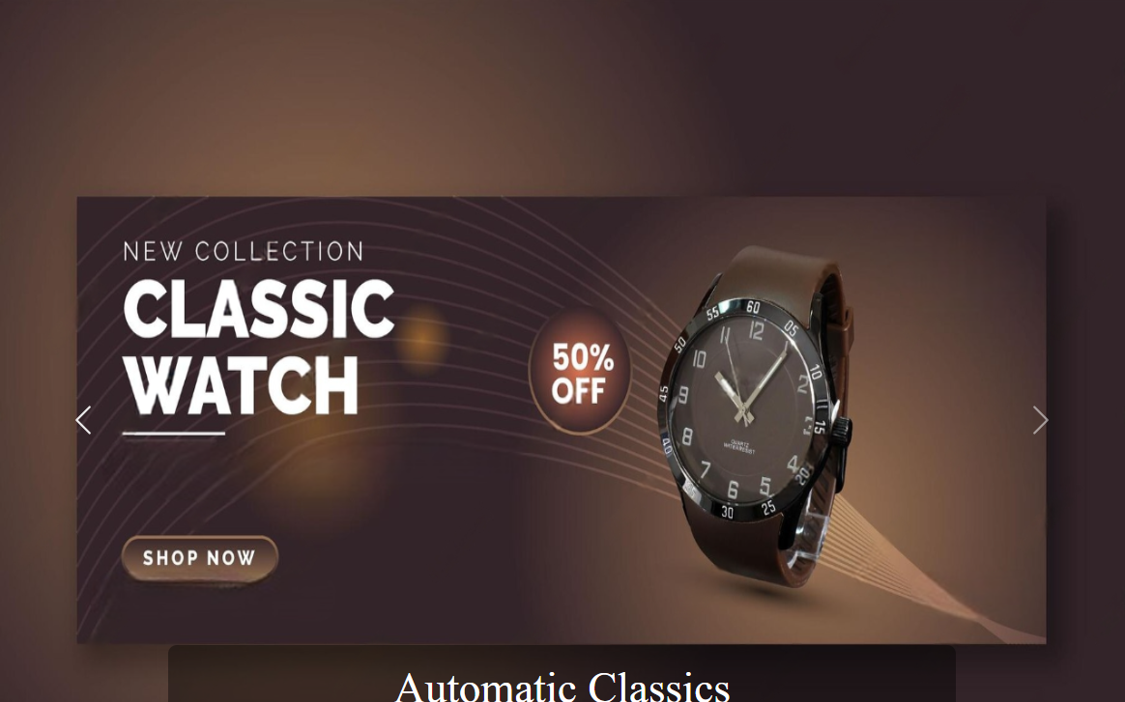
Home Page – Overview
Introduction with images and links to Watches
Each image navigates to detailed info.
Clean layout with Bootstrap cards or grid.

Slide 7
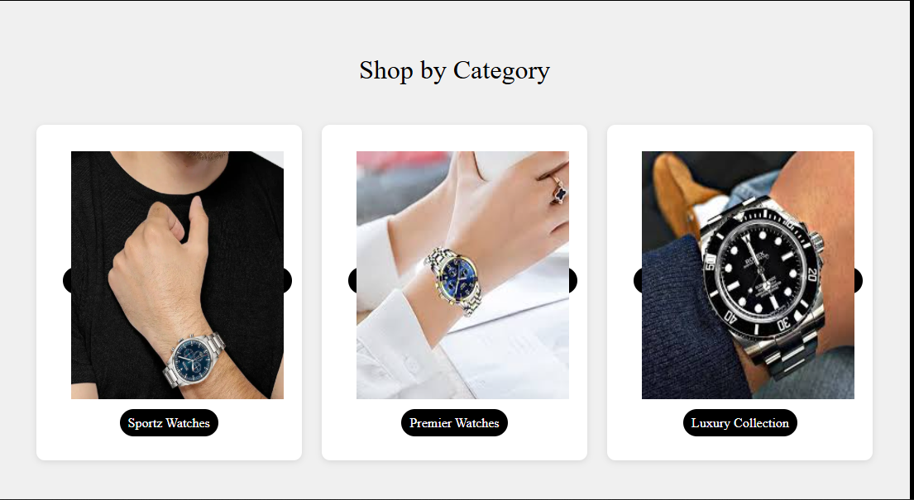
Shop Category
Luxury Smartwatches
Experience timeless design fused with cutting-edge technology — perfect for professionals and trendsetters.
Classic Digital Timepieces
Reliable, easy-to-read watches with alarms, stopwatches, and multi-time zones for everyday use.
Limited Edition Collection
Own something rare — hand-crafted models made with premium materials and bold style.

Slide 8
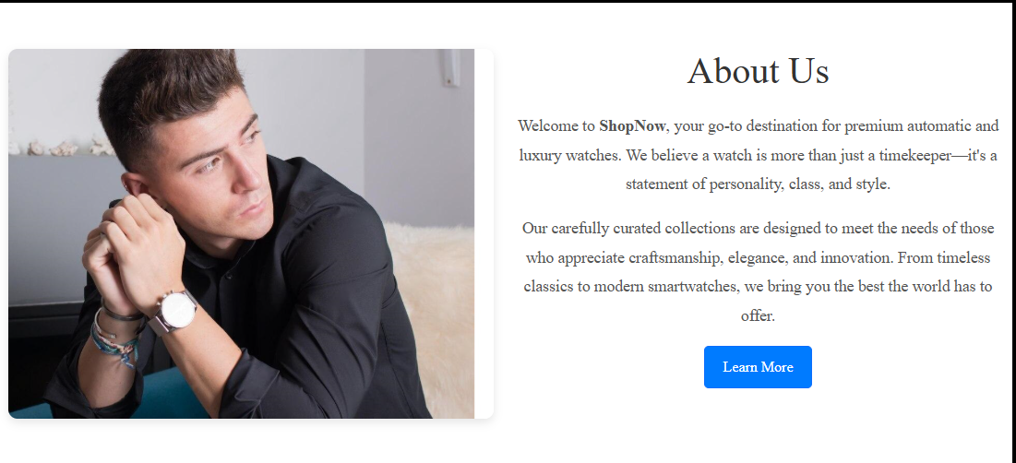
About Pages
🕰️ Who We Are
Welcome to Shop Now – your trusted source for premium automatic and luxury watches.
💎 Our Belief
We believe a watch is more than a timekeeper – it's a symbol of personality, class, and timeless style.
🎯 Our Collection
Explore a curated range of watches that celebrate craftsmanship, elegance, and technological innovation.
🌍 What We Offer
From heritage classics to the latest smartwatch trends, we bring you the finest timepieces from around the world.

Slide 9
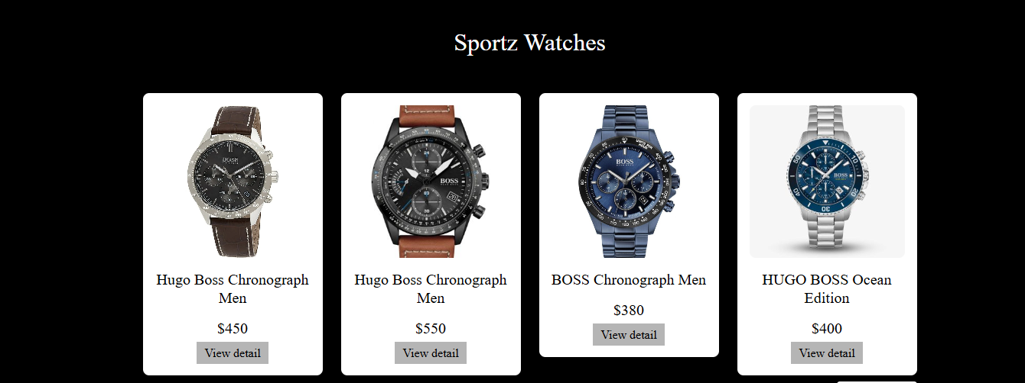
Observatories and Solar System
⌚ Sports Watches
Built for performance – shock-resistant, waterproof, and durable.
Features like stopwatch, GPS, and fitness tracking for active lifestyles.
🏆 Premier Watches
A collection of high-end timepieces with elegant engineering.
Perfect blend of style, accuracy, and lasting quality.
💎 Luxury Watches
Showcasing timeless elegance and elite craftsmanship.
Embellished with gold, diamonds, and finest leather straps.

Slide 10
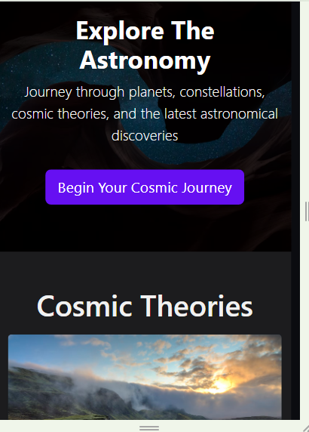
User Interface & Design Features
Responsive Bootstrap layout
Top menu navigation
Clean color scheme and consistent fonts
Mobile and desktop compatibility

Slide 11
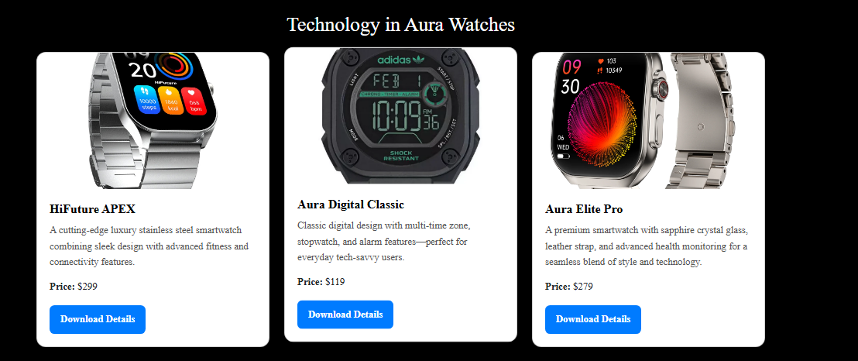
Aura Watches Technology
Informative and well-organized astronomy website
Meets platform and browser requirements
Rich visual design using HTML5, CSS, and Bootstrap
Interactive and educational experience for users

Slide 12
Thank You!
Questions & Feedback

